Slide 1

Lesson 2
Informative Presentations

Slide 2
Contents
Why informative presentations?
Types of informative presentations
Organization of informative presentations
Lesson focus: Introduction

Slide 3

1. Why Informative Presentations?
To build understanding and awareness
Notes:
The main purpose of an Informative presentation is to build understanding and awareness. Therefore, the information that you give your audience must be always NEW. Do not choose the easy way; do not tell plain facts.

Slide 4
2. Types of Informative Presentations
Presentations about objects
Presentations about processes
Presentations about events
Presentations about concepts
Presentations about issues
Notes:
‹#›
All the topics you meet belonging Informative presentations can be classified into five categories.
Objects include any items you see physically see and touch: a famous person, a place, a product, etc.
Processes are about how you do things or steps to do things.
Events include what happened, is happening, or will happen. (past, present, future)
Concepts are abstract things like happiness, Micro-economics, criminal psychology, etc.
Issues are not always problems; they are things that cause concerns or attention, for example: climate change, game addiction, etc.

Slide 5
SORT THEM OUT!
How to do Yoga at home
A recent earthquake in Japan
karaoke noise pollution
iPhone 14 Pro Max
Minimalism
Notes:
‹#›
Process
Event
Issue
Object
Concept

Slide 6
3. Organization of Informative Presentations
Chronological
Spatial
Topical/psychological
Cause - effect
Problem - solution
Notes:
When you are given a topic for an informative presentation, first you have to decide which type it is (process, issue, for example), then you choose a relevant organization to develop your topic.
Example 1: How to perform Yoga at home
Type: Process
Organization: Chronological (time order)
Example 2: Coronavirus pandemic in the world so far
Type: Issue
Organization: Cause-Effect or Problem/Solution
Example 3: Vietnam as a tourist destination
Type: Object
Organization: Topical
“Topical” means you can choose to talk about any topic you think is important first: you may think culture is the most important; your friend may think history is the most important, etc.

Slide 7

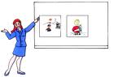

Tips for Effective Informative Presentations
First,
Second,
Third,
What does ‘anthropology’ mean?
Notes:
Do not talk about the information that everyone already knows. They will get bored.
Have a clear structure: This is spoken language; if you are not clear, the audience can miss your points easily.
Don’t use complex vocabulary and structure: if you don’t know something, assume that your audience do not know it, either. Therefore, you have to define difficult terms or give explanations.
Use visual aids to support your presentation.
Note: The next slide is the summary of these tips.

Slide 8

Tips for Effective Informative Presentations
Present new and interesting information
Strive for clarity
Define terms
Use visual aids

Slide 9
Structure of a presentation
Introduction
Body
Conclusion
Tell them what you’re going to tell them.
Tell them.
Tell them what you told them!
Notes:
A presentation is like an essay: it has three parts: introduction, body, and a conclusion.
Today, we’ll focus on how to write an effective introduction. This is the most important part to attract your audience. If you are boring during this part, your audience will get away and your whole presentation will be a failure. So, strive hard from the beginning.

Slide 10
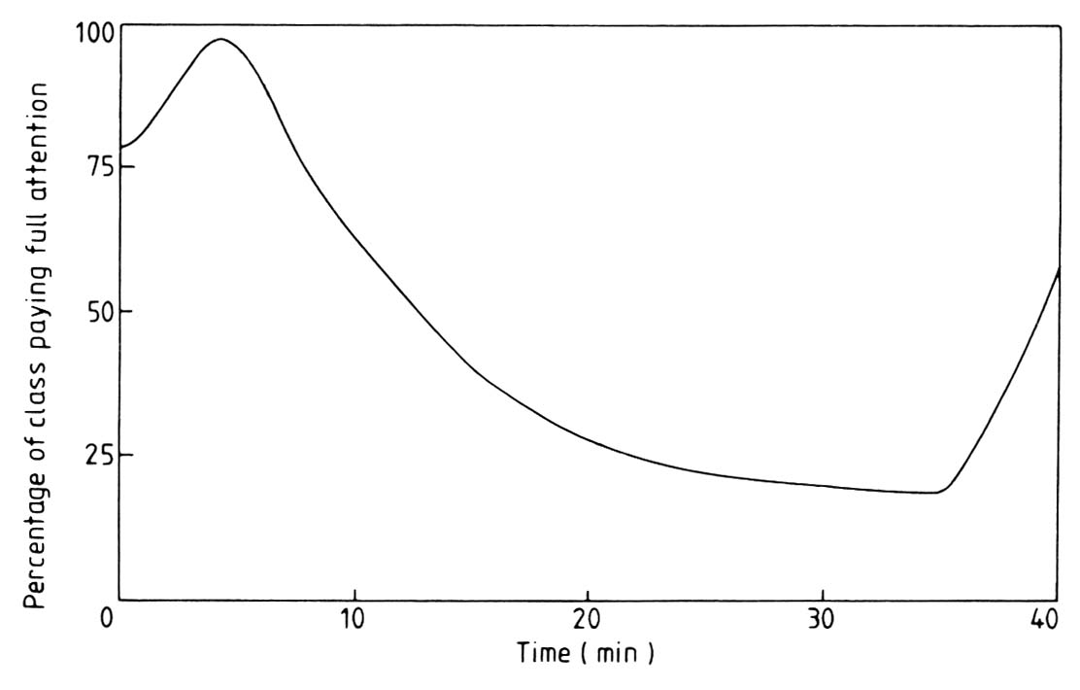
…but talks are delivered to audiences with limited attention spans
Audience attention curve
Notes:
This chart shows that your audience are always interested in the introduction, then their attention declines until you signal the conclusion.

Slide 11
Audience attention increases as you signal the end of the talk – so avoid false endings!
Audience attention curve

Slide 12
4. INTRODUCTION OF A PRESENTATION
What to include?
CHECKLIST
Your name and position
The title/subject of your presentation
The purpose of your presentation
The length of time you will take
The main parts or points you will cover
Any visual aids you will use
When the audience may ask questions
A reference to the audience connected to your topic
Notes:
Do you include all of these elements in your introduction?

Slide 13


Elicit the steps in the introduction
McGraw-Hill
Notes:
‹#›
Listen to this introduction and check the elements in the checklist before.
Signposts:
First, …
Then, …
Next,….

Slide 14
PREVIEW/OUTLINE
First, I’ll give you some basic info. about the company.
Then, I’ll talk about our overseas stores.
After that, I’ll outline some strengths of the company.
Next, I’ll talk about career opportunities.
Finally, I’ll mention future plans of the company.

Slide 15
Introduction – Template 1 (5 elements)
Greeting and saying thank-you
Saying who you are
Saying what the topic is
Providing a preview/an outline
Setting the time for Q & A
Notes:
This is a brief introduction outline. It is standard, but not interesting. It is more suitable for company presentations. To gain more points for your mid-term exam, you need to have a more elaborate introduction.
In this introduction, you pay attention to the Preview or the Outline of the talk. This is the most important part of your Introduction, because the audience can predict and expect what you will talk about later. Remember:
Signal your key points with clear signposts: First, Second, Last… (For classroom presentations, you should limit your talk within THREE key points)
Use a parallel structure for your Preview: First, I’ll…. Second, I’ll… Don’t change the structure: First, I’ll tell you … Second, I’m going to discuss….
Vary the verbs for your presentation: First, I’ll mention… Second, I’ll talk about… Last, I’ll discuss…

Slide 16
Introduction – Template 2
Hello everybody. Thank you for spending your time coming to my presentation.
My name is Rose Dawson, and I’m a trainer at EPM Company, which is Effective Personal Management for short.
How many people in here have a hard time balancing school work, career, family, and personal time?
For many of you in here, time management can be a major struggle, but it doesn’t have to be.
I’ve been using and teaching time management strategies for years now, and it has made my life much easier to balance and my training work more effective.
In my talk today, first, I’ll discuss how to manage your school time, then work time, and finally family and personal time.
I will only take you four or five minutes, so if you have any question, please ask me when I finish my talk.
Now, let me begin the first part: tips for school time management.
Notes:
This Introduction template is more informative and interesting to the audience. Identify which elements make it more interesting? The answer is in the next slide.

Slide 17
Introduction – Template 2 (8 elements)
Greeting and thank-you
Self-introduction
Attention-getter
Topic-audience connection
Credibility
Preview
Time for Q&A
Transition
Notes:
When you write the script for your Introduction, just stick to this template and you will include 8 elements. I’ll give you more explanations:
3. You can gain your audience’s attention by telling a funny story, giving some shocking statistics, asking some rhetorical questions (no answers needed), quoting a famous person, etc.
4. You have to explain why the audience need to sit here listening to your presentation. Therefore, you have to connect them to the topic.
5. You have to make them trust you as a speaker: why you are here giving this presentation. For example, if I give a presentation on medicine, the audience will not trust me because I’m a language teacher. However, if I’m talking about to speak well in public, they will trust me. You can assume a role when you give a presentation. For example, if your topic is talking about Vietnam’s current economy, you may introduce that you are an economic analyst.
7. If you don’t set the rule for Q & A, your audience may stop you any time and ask questions. If you set the rule, you can postpone answering till the end of your talk.
8. You need to have a transition sentence to connect your audience to the first point of your presentation.

Slide 18
Introduction – Template 2
Greeting & thank-you: Hello everybody. Thank you for spending your time coming to my presentation.
Self-introduction: My name is Rose Dawson, and I’m a trainer at EPM Company, which is Effective Personal Management for short.
Attention getter: How many people in here have a hard time balancing school work, career, family, and personal time?
Connecting the topic to the audience: For many of you in here, time management can be a major struggle, but it doesn’t have to be.
Credibility: I’ve been using and teaching time management strategies for years now, and it has made my life much easier to balance and my training work more effective.
Preview: In my talk today, first, I’ll discuss how to manage your school time, then work time, and finally family and personal time.
Time for Q&A: I will only take you four or five minutes, so if you have any question, please ask me when I finish my talk.
Transition: Now, let me begin the first part: tips for school time management.

Slide 19
C, H, A, D, B, F, G, E
REARRANGE THE TEXTS
Well, what comes to mind when you see candles? We associate candles with celebrations or special occasions. Candles date back to the Ancient Egyptians who are credited with making the first candles. They used torches made by soaking the spongy core of reeds in melted tallow.
Two years ago, I made candles for decoration and also for people to purchase during a medieval Madrigal dinner production that our A Cappella choir put on. I have also made candles since then as a part of my church youth group around the Christmas season.
Good afternoon everyone. Welcome and thank you for your attendance today.
I’m sure all of us at some point have used candles for celebrations, romantic experiences, or just plain decoration. The great part about making your own candles is that they are inexpensive to make and you shape the wax into something special. What could be more special than to make someone you love a homemade gift?
Let’s start by doing the most important thing, which is to find all of the materials, and tools needed to make candles.
I will explain three basic things which include how to go about finding the right materials, how to melt the wax, and how to make a molded ice-cube candle.
Feel free to interrupt me during my talk if you feel like asking any question.
I’m Martha Jones, and I’m a member of the Handicraft Club.
Notes:
Logical order:
C
H
A
D
B
F
G
E

Slide 20

Class work
Plan and write the script for the introduction to introduce HCMC International University. Your audience are:
High school students considering a college choice
Partner universities looking for co-operation opportunities
Food suppliers for IU canteen

Slide 21
Link to submit:
Please include your names in the script, so that I can check your participation.
https://drive.google.com/drive/folders/1zaMFB0SBC6ppFi0YhBrohLGvFSyW5_yY?usp=sharing

